Slide 1
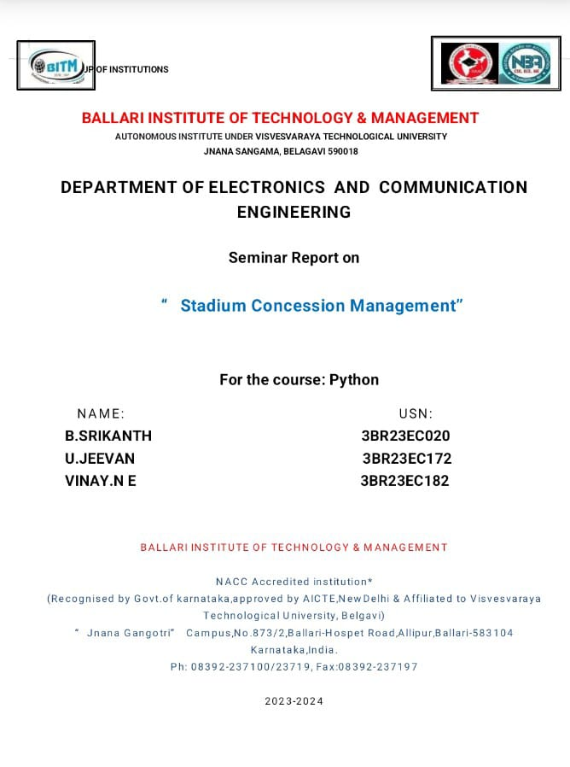

Slide 2
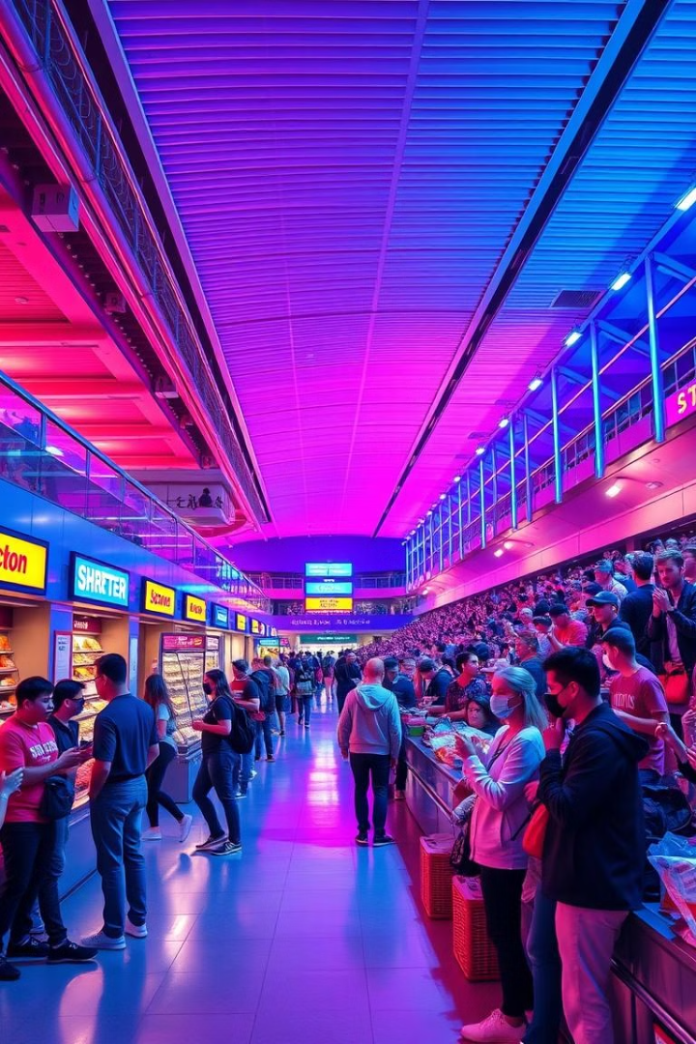
Stadium Concession Management
BY-VINAY N
JEEVAN
SRIKANTH

Slide 3
INTRODUCTION:-
Stadium concession management involves overseeing food and beverage services within sports arenas, concert venues, and other large event facilities. Effective management of concessions is crucial for enhancing the customer experience, maximizing revenue, and ensuring operational efficiency.

Slide 4
Challenges in Concession Operations
Long Wait Times
Inventory Management
Data Collection
Frustrated fans waiting in long lines.
Running out of popular items frequently.
Limited data on fan preferences and sales.

Slide 5
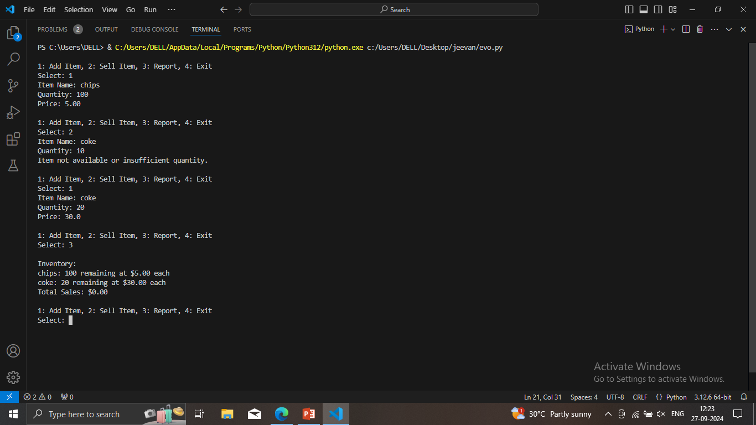
OUTPUT OF THE CODE:-

Slide 6

Key Features of the Concession Management System
1
Real-Time Inventory Tracking
2
Automated Ordering
Track inventory levels across all concession stands.
Place orders with vendors and manage deliveries.
3
Sales Reporting and Analytics
4
Customer Feedback Integration
Generate insights on best-selling items and popular times.
Collect customer feedback for product improvement.

Slide 7

Streamlining Order Processing and Fulfillment
Order Placement
Automated order processing
Order Tracking
Real-time updates on order status
Fulfillment
Optimized routes for delivery to concession stands

Slide 8





Conclusion and Future Enhancements
Mobile App Integration
Robotics and Automation
Enable mobile ordering and loyalty programs.
Explore robotic assistants for food preparation.
Advanced Analytics
Cashless Transactions
Utilize AI for predictive modeling and insights.
Implement contactless payment options.

